Slide 1
Managing working capital

Slide 2
Cash is back as King
In tough time firms must do everything to free up their cash.
In a recessionary economy improving the condition requires tight cash mgt.
Working Capital can give cash within short period without major restructuring.

Slide 3
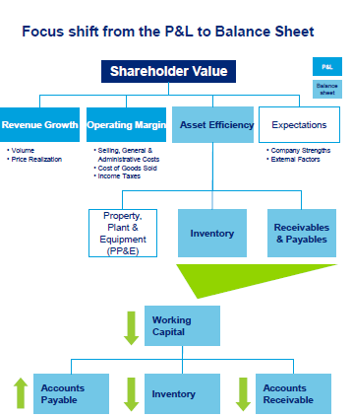

Slide 4
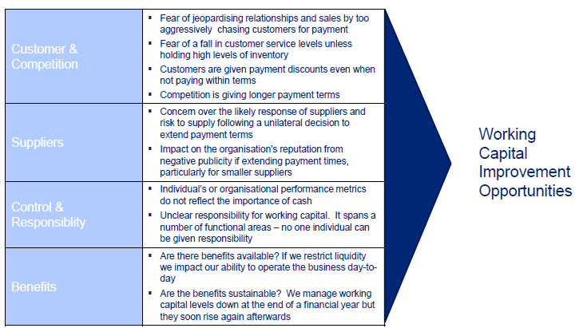
Barriers for optimizing Working Capital

Slide 5
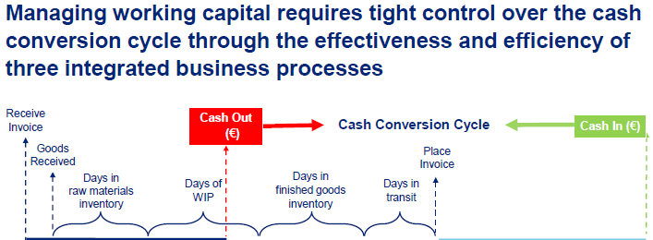

Slide 6
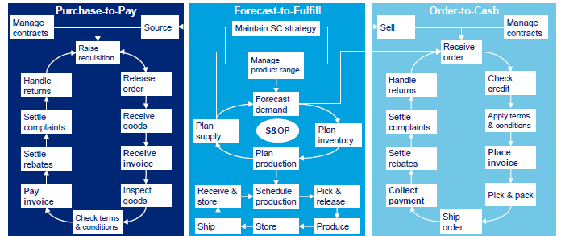

Slide 7
Cash @ Risk : Working Capital Reduction
Working Capital Reduction through Data Analysis.
Recovery – Data analysis on inaccurate, incomplete and double transactions and non compliance with contractual terms.
Optimization – Strengthen customer payment terms, cash discount, analyse actual payment vs. payment terms, analyse days of supply vs. revenue.
Transformation – Process, organization and system design

Slide 8
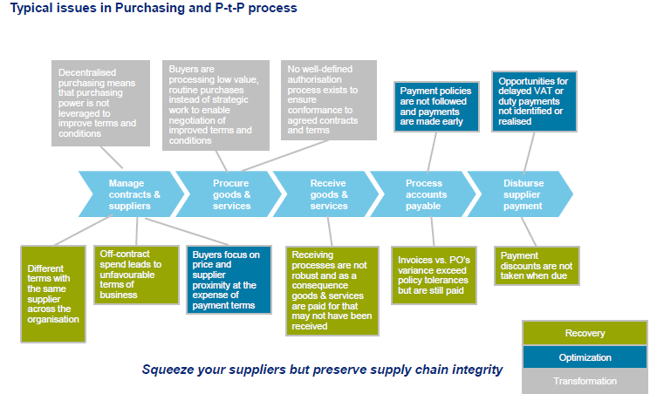

Slide 9
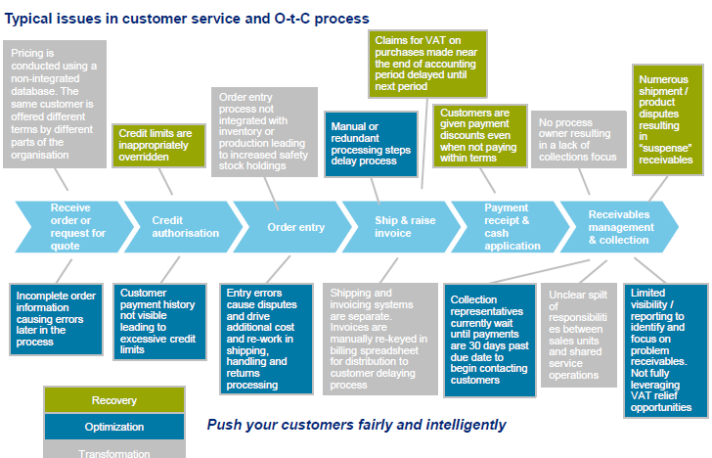

Slide 10
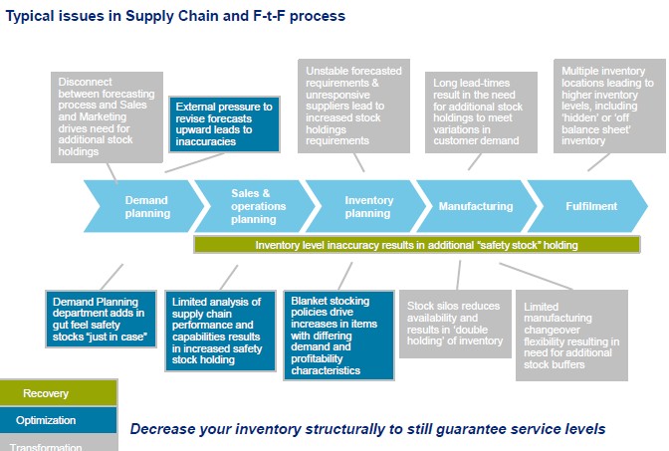

Slide 11
